Slide 1

ANALYSING HOUSING PRICES IN
METROPOLITAN AREAS OF INDIA
1)INTRODUCTION
1.1 OVERVIEW
Meaning of housing prices?
The sums in money for which houses may be bought or sold.
LINK:
1)
https:github.com/Pravina17/Analysing-Housing-Prices-In-Metropolitan-Areas-Of-India_NM2023TMID0 2673
2)https://public.tableau.com/app/profile/pravina.s5167/vizzes
CONTENT
*collection of prices of new and resale houses located in the metropolitan areas of india.
*The amenities provided for each houses,with 40 explanatory variables describing various aspects of new resale houses in the metropolitan areas of india ,one can predict the final price of houses in these regions.
1.2 Purpose
A POST-PENDEMIC NEED FOR SECURITY,INCREASED SAVINGS,AND RELATIVELY LITTLE INCOME DISRUPTION FOR MIDDLE AND HIGHER-INCOME GROUPS.
*THE PRIMARY PURPOSE OF HOUSING IS TO PROVIDE SELTER TO INDIVIDUALS AND FAMILIES. PEOPLE NEED A PLACE TO LIVE,AND HOUSING FULFILLS THIS BASIC NEED.
*DATA COLLECTION ,MARKET RESERCH,ECONOMIC ANLYSIS,LOCAL FACTORS HOUSING PRICES IS A COMPLEX TASK.REMEMBER THAT THESE PROJECT ARE NOT GUARANTEED AND SHOULD BE USED AS A GUIDE RATHER THAN A DEFINITIVE PREDICTION
2)PROBLEM DEFINITION &DESIGN THINKING
2.1 EMPATHY MAP

Slide 2
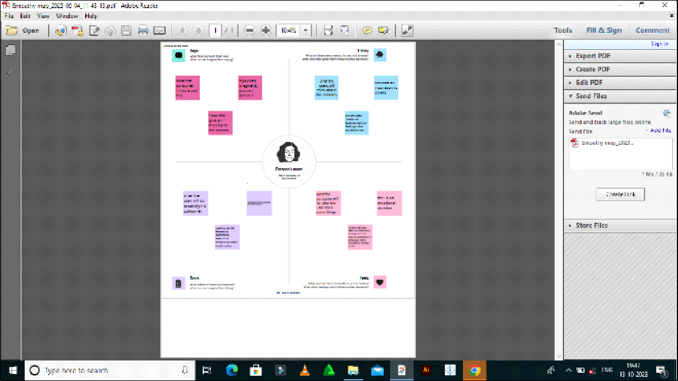
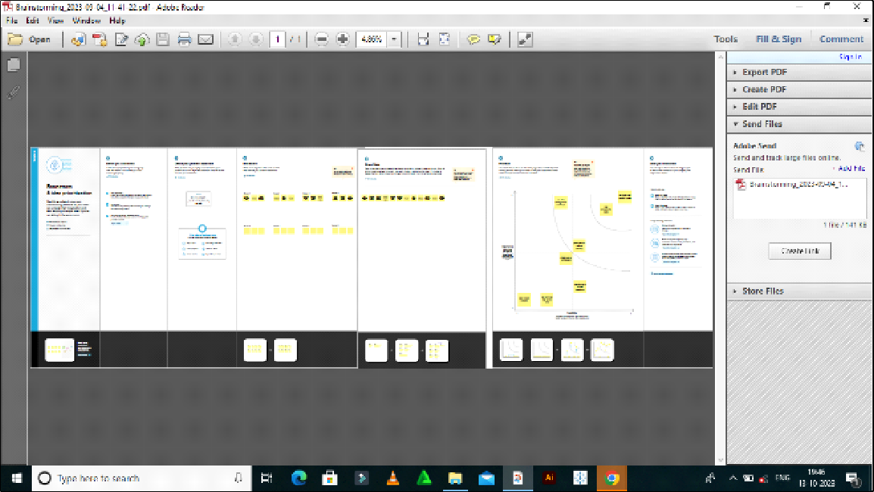
2.2 BRAINSTORMING MAP
3)RESULT
DASHBOARD 1

Slide 3
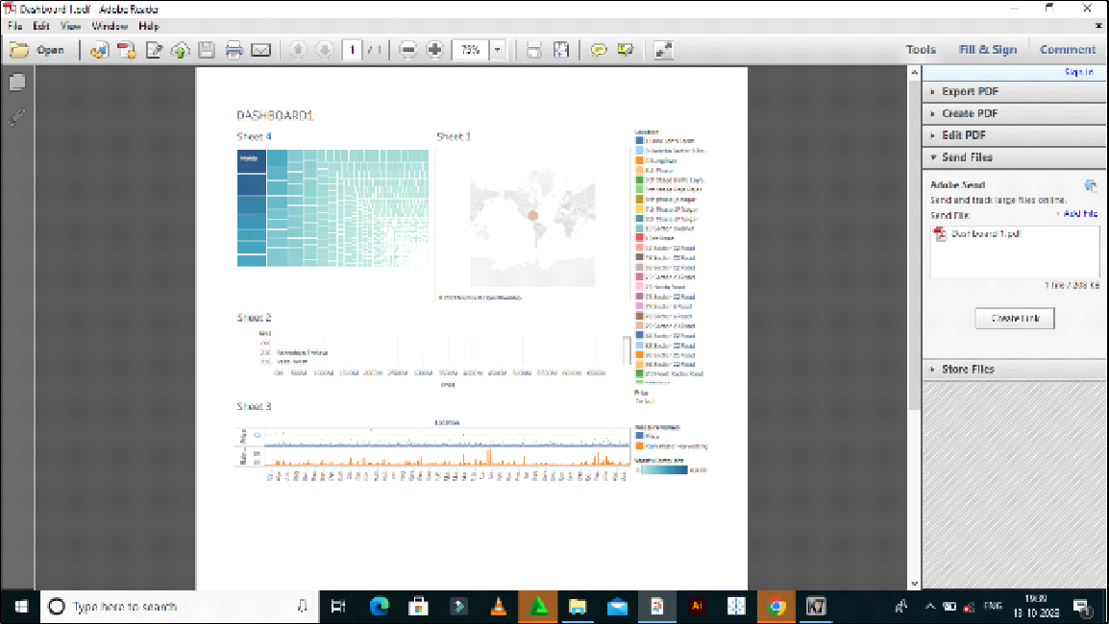
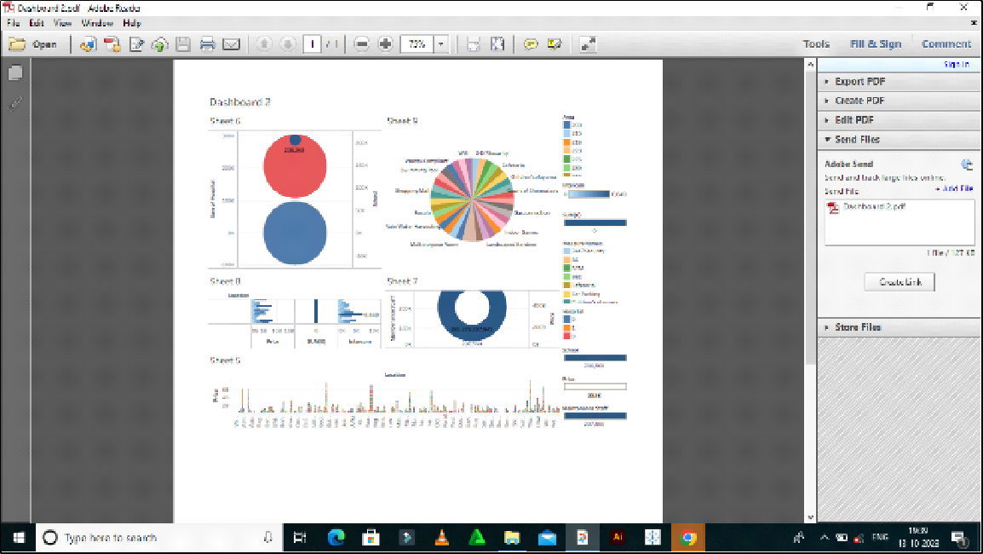
DASHBOARD 2
STORY

Slide 4
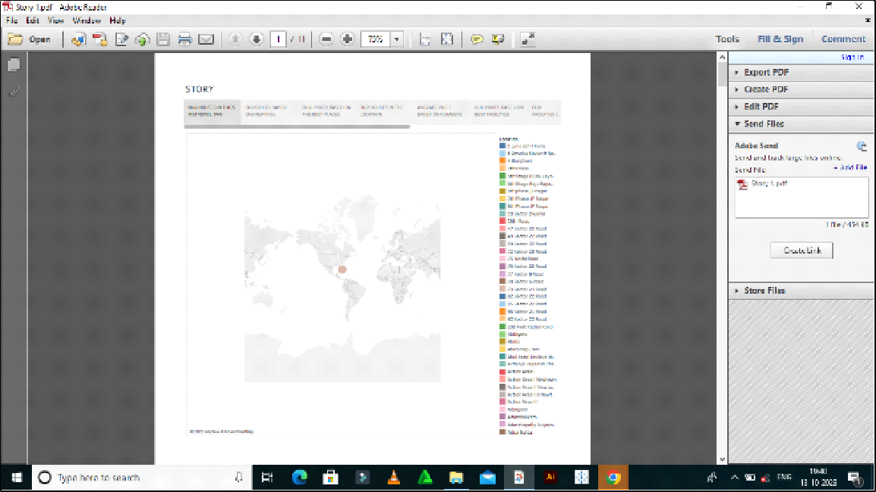
4)ADVANTAGE &DISADVANTAGE
ADVANTAGE
ECONOMIC STABILITY: A well-managed housing market can contripute to economic stability by reducing the risk of housing bubbles and crashes.
DISADVANTAGE
INEQUALITY: It's possible that measures aimed at controlling housing prices may unintentionally create inequalities or limit housing choices for certain demographics.
APPLICATION
The solution for managing housing prices in metropolitan areas can be applied in various contexts and locations where housing affordability and market stability are significant concerns.these solution can be adapted and implemented in the following areas:
METROPOLITAN CITIES,TIER 2 AND 3 CITIES,DEVELOPNG URBAN AREAS,TOURIST DESTINATION,HISTORIC AND CULTURAL DISTRICTS,SMART CITIES,RURAL-URBAN TRANSITION ZONES etc.....
CONCLUSION
The analysis of housing prices in metropolitan areas in india has revealed a multifaceted landscape with both challenges and oppurtunities. the purpose of this study was to understand the factors influencing housing prices ,propose solutions,and identify areas where these solutions can be applied
FUTURE SCOPE
Several potential enhancements can be made in the future to improve the management of housing prices

Slide 5

in metropolitan areas,Advanced data analytics and artificial intelligence can be used to better predict housing prices trends,enabling more accurate policy decisions
8)Data literacy with tableau

